Slide 1
state is the safest for foreigners
Q9Which state is the safest for foreigners?
Query:-
SELECT STATE_UT,sum(TOTALIPCCRIMES) as total_crimes from
"01_District_wise_crimes_committed_IPC_2001_2012"
GROUP by STATE_UT
ORDER by TOTALIPCCRIMES DESC;

Slide 2
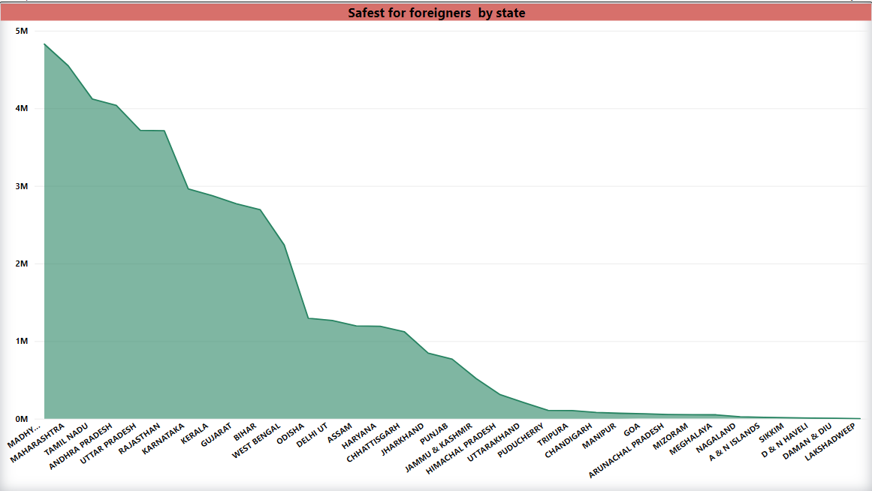
Our query screenshot:- 1. ﻿MADHYA PRADESH accounted for 10.08% of total_crimes.

